Slide 1









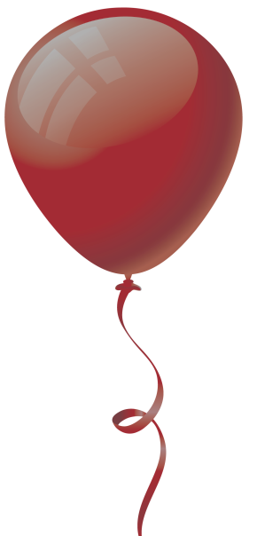


H
L
E
L
O
?
C
L
O
R
S
O

Slide 2

red

Slide 3

blue

Slide 4

yellow

Slide 5

green

Slide 6

orange

Slide 7

pink

Slide 8

purple

Slide 9

brown

Slide 10

black

Slide 11

white

Slide 12

?
?
?
gray
?
?
?

Slide 13
Very
Good.

Slide 14
A
little faster.

Slide 15
red

Slide 16
blue

Slide 17
yellow

Slide 18
green

Slide 19
orange

Slide 20
pink

Slide 21
purple

Slide 22
brown

Slide 23
black

Slide 24
white

Slide 25
?
?
?
?
gray
?
?

Slide 26
Very
Good

Slide 27
Say the colors backwards

Slide 28
gray

Slide 29
white

Slide 30
black

Slide 31
brown

Slide 32
purple

Slide 33
pink

Slide 34
orange

Slide 35
green

Slide 36
yellow

Slide 37
blue

Slide 38
?
?
?
?
red
?
?

Slide 39
Nice!

Slide 40
All
Together!

Slide 41










red
yellow
green
orange
blue
purple
black
pink
white
brown

Slide 42
?
?
?
?
gray
?
?

